Slide 1
Whole Body and Hand Vibration Monitoring in Marine settings
Dr Mary Daly Dr Simon Woodworth

Slide 2
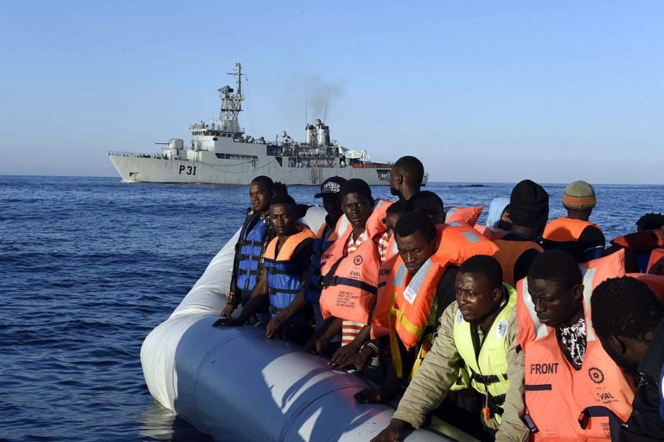
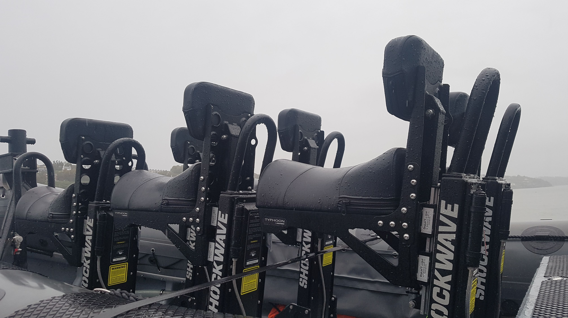
Overview
Irish Naval Service makes extensive use of RHIBs (Rigid Hull Inflatable Boats for:-
Search And Rescue
Humanitarian
Interdiction of trawlers
Interdiction of drug traffickers
Wave impact on an RHIB travelling at speed can be considerable
Shock absorbing seats are used.

Slide 3
Whole Body and Hand Vibration
Medical issues
Prolonged exposure results in back and neck pain (WBV) and seriously disabling problems with hands wrists and lower arms (HAV).
Low-frequency motion, from about 5 to 20 Hertz (cycles per second), is thought to be potentially more damaging than higher frequency motion. Vibration at frequencies below 2 Hz and above 1,500 Hz is thought to be less damaging.
Applicable Exposure Standards
IS02631: Mechanical vibration and shock -Evaluation of human exposure to whole-body vibration
UK HSE: Controlling vibration risks
Irish HSA 2007: Control of vibration at work

Slide 4
Exposure Limits
Hand-Arm Vibration (HAV)
The daily exposure limit value standardised to an eight-hour reference period shall be 5m/s2;
The daily exposure action value standardised to an eight-hour reference period shall be 2.5 m/s2.
Whole-body vibration (WBV)
The daily exposure limit value standardised to an eight-hour reference period shall be 1.15 m/s2
The daily exposure action value standardised to an eight-hour reference period shall be 0.5 m/s2

Slide 5
So what’s the problem?
The applicable standards and measurement techniques work well for construction equipment, hand tools and heavy machinery.
Diggers, Kango hammers, Drills, Chainsaws, etc.
The environment in a RHIB is much more variable
Standards are not normalised for marine use

Slide 6
Investigations so far
Naval Service in conjunction with Dell :-
Dell identified suitable Ruuvitag sensors for body use and integrated them with an IoT hub to gather data.
Measurements taken in Cork harbour with a Naval Service RHIB
Hand
Belly (kidney nelt)
Neck
Hull
The RNLI (Poole, Dorset) has since become involved
Their concern is impact spike delivering a high G shock

Slide 7
UCC involvement
Staff and students of the CUBS BIS MSc in Business Information Analytics Systems have been providing analytic support
Part of relevant modules, in particular Programming for Data Analytics
Using Anaconda distribution of Python
We have done some initial naïve estimates of g exposure and have normalised to 8-hour exposure standard.
Efforts have focused on filtering data and understanding context of what is being measured

Slide 8
Problems and challenges
Can we measure body and hand vibration exposure without having to wire up crew members all the time?
E.g can we derive exposure from seat and hull sensors?
Ruuvitag sensors have huge battery life and are waterproof but are limited in capability:
Only 3-axis (accelerometer)
Cannot easily filter out G due to Earth
Therefore cannot derive linear acceleration

Slide 9
Immediate next steps
Upgrade sensors to MetaMotionC / MetamotionR
More expensive
Provides 9-axis measurement (Accelerometer, Gyroscope, Magnetometer)
On-board sensor fusion yields Linear Acceleration
Integrate with Dell IoT Hub
Bluetooth Beacon
Gather fresh data
Several bost trips required

Slide 10
Analytics plan
Gather data
Frequency filters
Exposure measures
Correlation of body, seat and hull measurements
Log short duration impact spikes
Build models to:
Deliver % daily exposure measure for given time at sea
Estimate exposure given hull type (design issue for RNLI)
Estimate likely impact exposure given hull type and sea conditions

